Slide 1
FIZZBUZZ PROGRAM presentation
Group 14
NETRa v (046)
HARSHITHA g(017)
ESHAN K THARIK(044)
SIRAJ EK(043)

Slide 2
Problem statement
The system prints numbers 1 to 50, replacing multiples of 3 with “Fizz”,5 with “Buzz”, and both with “FizzBuzz”. Write C and Python programs to preform this task. Explain the effects if the loop begins from 0.

Slide 3
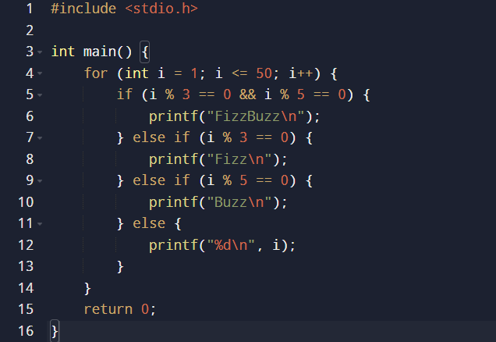
🔘C PROGRAM
Program:

Slide 4
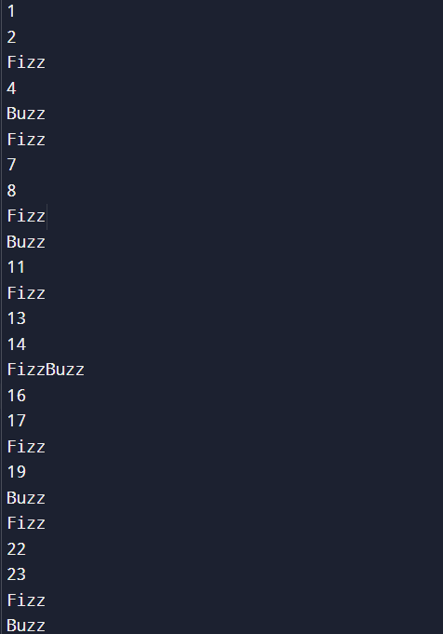
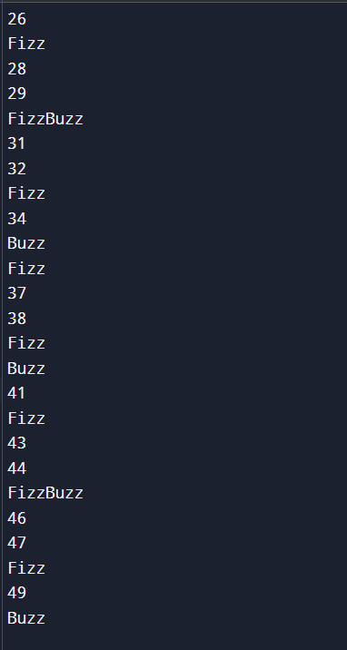
OUTPUT:

Slide 5
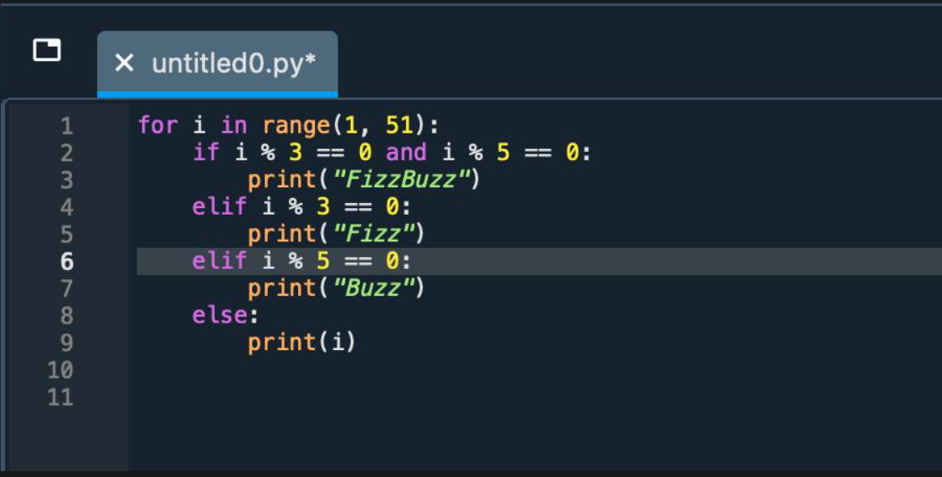
🔘Python PROGRAM
Program:

Slide 6
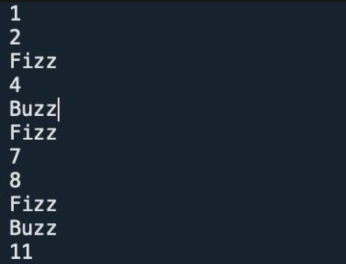
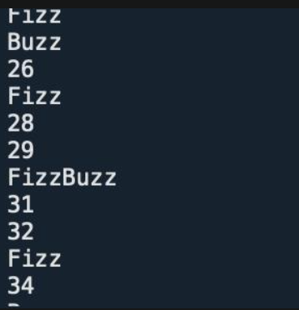
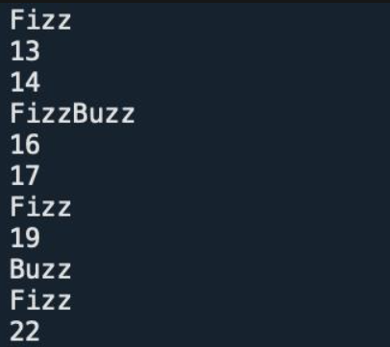
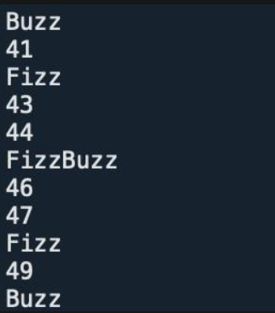
OUTPUT:

Slide 7
COMPARISON OF C AND PYTHON CODE
Aspect | C Program | Python Program
Language Type | Compiled, low-level language close to hardware | Interpreted, high-level language
Code Structure | Requires explicit syntax — main function, data types, semicolons, and braces {} | Uses simple indentation and keywords; no need for main function or type declarations
Loop Syntax | for (int i = 1; i <= 50; i++) | for i in range(1, 51):
Printing Output | Uses printf() with format specifiers | Uses built-in print() function
Conditional Syntax | Requires parentheses and braces for if, else if, and else | Uses indentation instead of braces; cleaner and shorter syntax
Ease of Writing | Longer code due to strict syntax and variable declarations | Shorter, more readable, beginner-friendly
Execution | Needs compilation (e.g., using GCC compiler) before running | Runs directly in an interpreter (e.g., IDLE or command line)
Performance | Faster execution due to compilation and low-level control | Slower compared to C, but sufficient for small tasks like this
Error Handling | Compile-time errors detected before execution | Errors are found during runtime
Output Format | Same output pattern (numbers, “Fizz”, “Buzz”, “FizzBuzz”) | Same output, easier to format
Use Case | Suited for performance-critical and system-level programming | Suited for quick scripting, automation, and teaching programming logic

